Slide 1
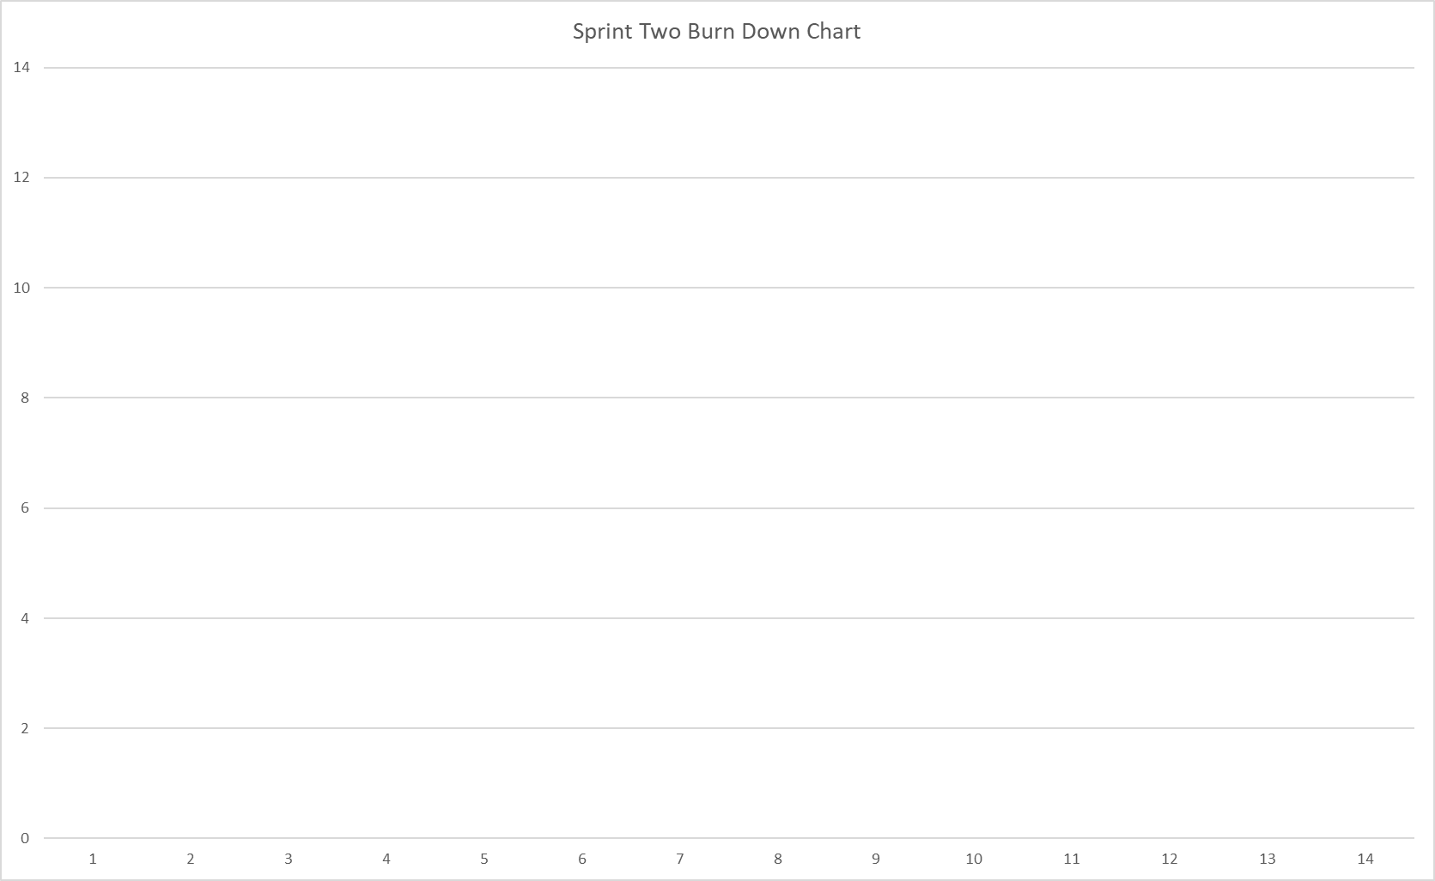
Tasks
Days
Ideal Effort
Actual Effort

